Slide 1


Skyview Elementary School
Title l Annual Meeting
2024-25

Slide 2



All About Title l
Title I is the largest federal assistance program for our nation’s schools.
The program serves 99 schools in Pinellas County including eligible students in 39 non-public schools.
The Title l goal is that every student achieves high levels of academic proficiency.
Notes:
Highlight the Title l Program here in Pinellas County.

Slide 3

Skyview Elementary School
September 26, 2024
6:00pm
Media Center
Katie Hamm, Principal
2024-25 Title l Annual Parent Meeting
Notes:
Evidence: Upload completed presentation and recorded feedback as part of the evidence to support the Annual Meeting Materials. Do not forget the sign-in sheets, and survey/feedback that you receive throughout the meeting.

Slide 4
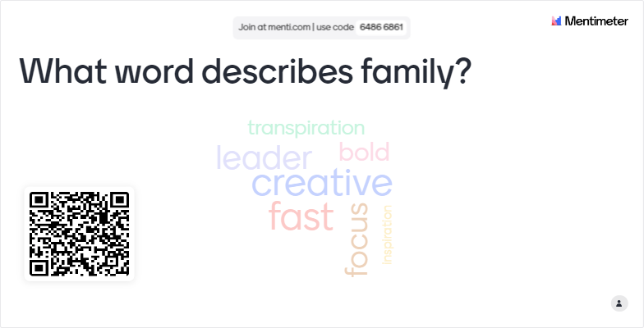
Notes:
Insert icebreaker or a “get to know you/your family” activity here! Use the icebreaker to take attendance AND get to know something about your families to help support student achievement.
Evidence: Use the responses from icebreaker as evidence to support the next steps related to future engagement activities and student achievement.

Slide 5

Title I Funding Process
2. Florida Department of Education
1. Federal Government
Skyview Elementary
3. Pinellas County Schools
Notes:
The Florida Department of Education receives funds from the federal government. Districts receive Title I funds from Department of Education, and the school district distributes these funds to schools based on the percentage of children eligible for free/reduced price lunch; however, students do not have to be from low-income families to receive help.

Slide 6


Title l Supplemental Resources
Definition: provided in addition to what is already present or available to compete or enhance it
Notes:
Definition: provided in addition to what is already present or available to complete or enhance it extra academic support and learning opportunities for economically disadvantaged students.

Slide 7


Slide 8
TITLE l PROGRAMS PROVIDE SUPPLEMENTAL SUPPORT
Because of Title I Funding, Skyview now has
  Math Coach – Cali Kulavic
  Reading and Literacy Coach – Kimberly Arnold
  Behavior Coach – Jenn Peers
Additional Resources
  Make and Take materials for content night
  Presenters for our students
    Mad Science
    Corey Thornton
Expected goals from resource funding
  Improve Math proficiency – 60%
  Improve Science proficiency – 65%
Notes:
Use additional slides if necessary. This is where you want to really highlight Title I funding and how it positively impacts your scholars!
Additional supplemental personnel (add specific positions)
Additional training opportunities for school staff (add specific trainings offered at your site)
Extended Learning Opportunities (before and/or after school programs)
Supplemental teaching materials, equipment, and technology
Parent and Family Engagement Resources and Training Workshops

Slide 9


Let’s Celebrate!
Pinellas County Schools = A
Skyview Elementary = B
3rd – 5th Learning Gains = 67%, Math
3rd – 5th Learning Gains = 63%, ELA
L25 Learning Gains = 74%, ELA
Kindergarten Proficiency = 69%, ELA
Kindergarten Proficiency = 71%, Math
Notes:
Based on the FAST data and school grades, there is a lot to celebrate!!
How did your Title I Resources support or enhance the work that you were able to get done?

Slide 10
Title I Schoolwide Planning and Input
First
Second
Last
Seek Input from school, family, and community members determine how Title I funds are used based on a needs assessment.
Please attend
in-person meetings/trainings and complete surveys to provide input on Title I funding.
All Title I schools must document that parents are involved in the schoolwide planning process.
Notes:
Evidence for input – input from school can be a survey or notes, which include quotes related to what was shared as feedback AND how this input will be used to inform the PFEP and future engagement activities.
Evidence of Attendance – please include attendance of DIVERSE stakeholder group/s.

Slide 11
Skyview Elementary School’s Title I Parent & Family Engagement 2023-24 Budget
Total Allocation - $276,700
Math Coach & Support - $87,082.57
Reading Coach & Support – $65,059.44
Behavior Coach & Support - $97,732.64
Title I Crate – $1,440.00
Resources & Presenters - $25,385.35

Slide 12

Parent’s Right to Know
As a parent of a student attending a Pinellas County School Public School, you have the right to…
Be
Be provided information on your child’s level of achievement on assessments in Reading/Language Arts, Writing, Mathematics, and Science.
Request and receive information on the qualifications of your child’s teacher and supplemental personnel working with your child.
Be
Be notified of non-highly qualified or out-of-field teachers at the school.
Be
Be informed if your child is taught by a non-highly qualified teacher for four or more consecutive weeks.

Slide 13
Working Together for Student Success
School
School Improvement Plan (SIP)
Title
Title I Schoolwide Plan
Parent
Parent and Family Engagement Plan
School
School-Parent-Student Compact
Title l is now included as a part of the School Improvement Plan
Notes:
As a Title I parent you have the right to be involved in the development of the following plans and documents for our school which can be found on our website (insert website) to view as well as in the Parent Station located (insert location here).
Our school’s Title I Parent Station is located (insert location or photo of Title I Parent Station (front office and on the webpage). Please include photo as part of the evidence monitoring.
You will find a copy of our School Improvement Plan, Title I Schoolwide Plan, School’s PFEP, the School District’s PFEP, Parent’s Right to Know Memo, Upcoming Events, Compact, (insert other documents at your station)
School Improvement Plan (SIP)
Parent and Family Engagement Plan
Title I Schoolwide Plan
School-Parent-Student Compact

Slide 14

Parent-School-Student Compact
The purpose of the compact is to foster student achievement. By signing the Parent-School-Student Compact, (Insert name of school here), teachers, staff, parents and students agree to work together to share the responsibility of helping students meet or exceed state, district and school academic goals.
The Parent-School-Student Compact is updated every year to include parent, student, teacher, and staff input. Parent, student, teacher and staff comments are welcome at any time during the year.
Please review and sign your child’s Compact.
Our goal is to receive 100% signed compacts!
Notes:
At the elementary level, school compacts are used as a progress monitoring tool through the year during parent teacher conferences.

Slide 15
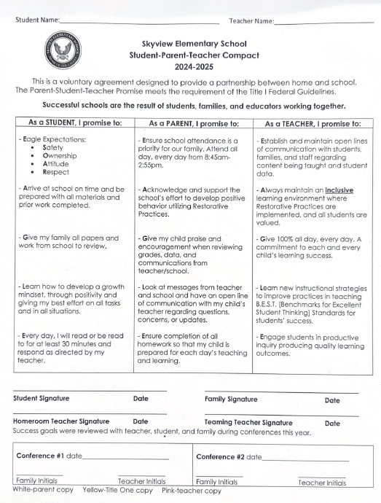
Sample School Compact
Notes:
Please insert the an example of your updated school compact. Highlight any things that unique to your school’s compact.

Slide 16

Parent and Family Engagement Plan (PFEP)
The PFEP Sections include information about the following:
  Parent trainings to increase student achievement
  Staff trainings for engaging parents
  Communication methods between home and school
  Flexible meeting times
  Accessibility for parents
  Coordinating with other Federal Programs
  To access the full LEA PFEP, please visit
  www.pcsb.org/titleone
Notes:
Provide information on the specific committees that parents can be involved. Include the purpose, date and time of meetings.
Explain the PFEP and its purpose.
Consider the evidence related Title I Crate, Sample of Evidence,

Slide 17
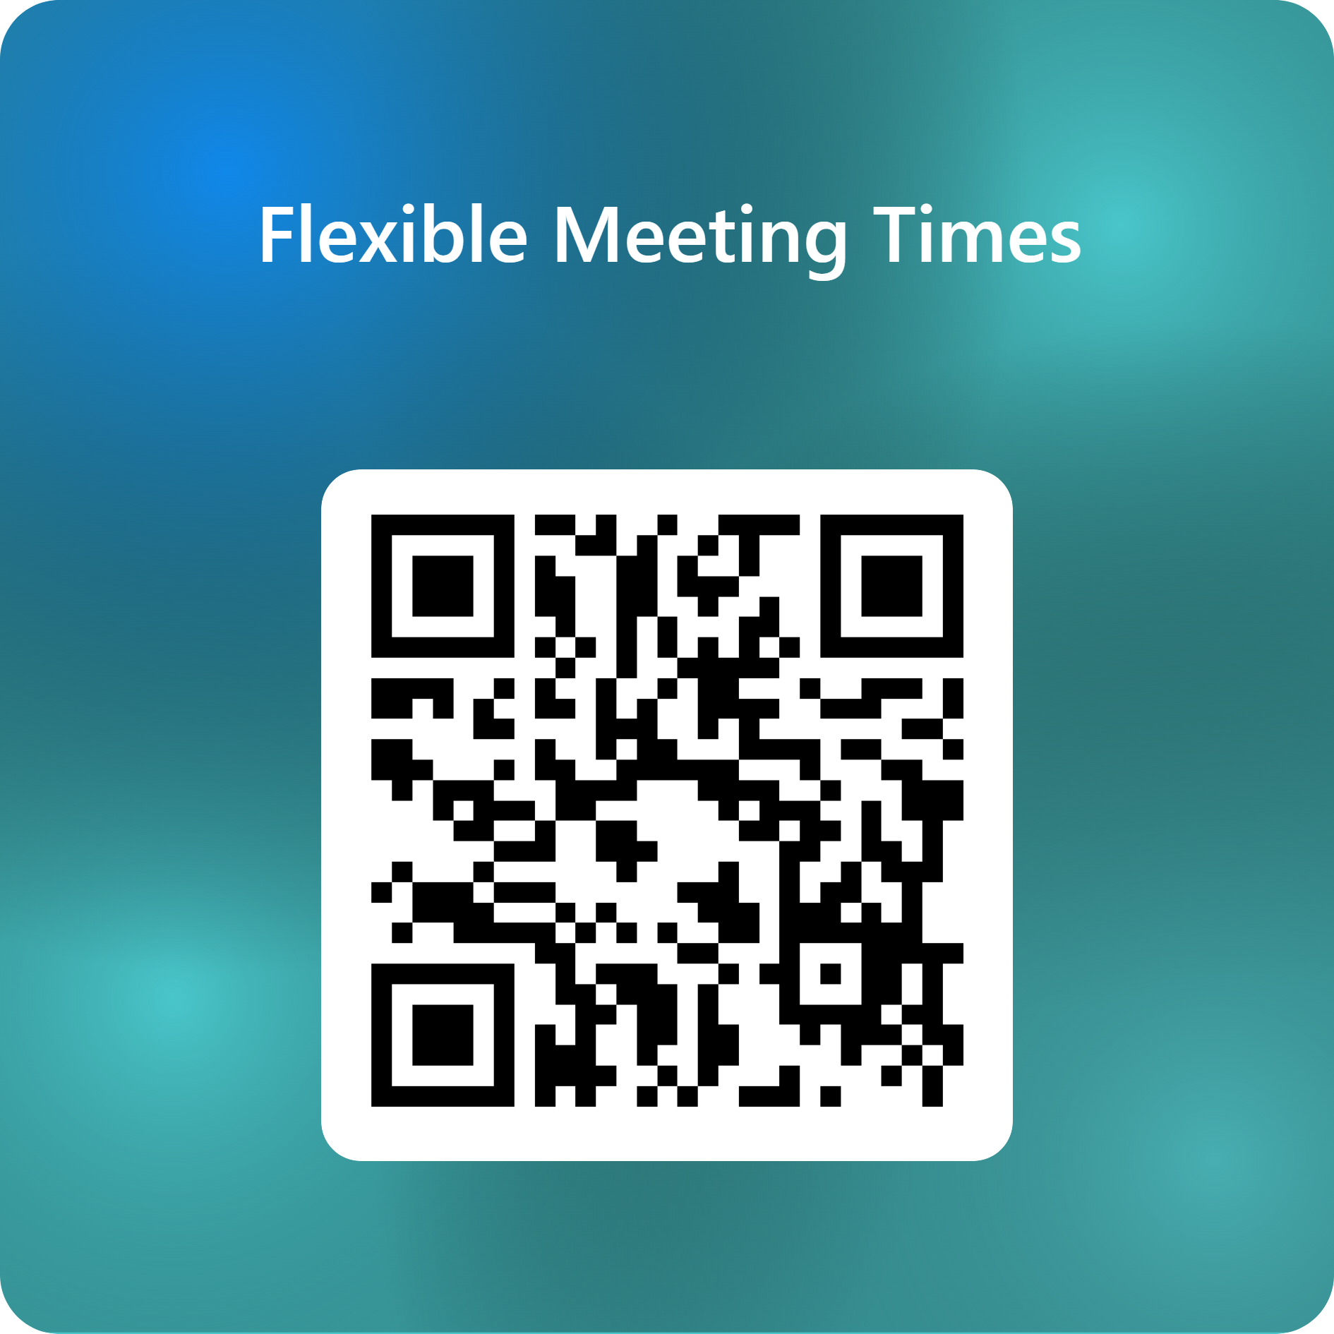
Opportunity for Two Way Communication
As mentioned in the previous slide, the PFEP ensures to provide families with flexible meeting times.
Notes:
Evidence – please keep this as evidence to support using feedback to inform flexible meetings.

Slide 18


Florida Benchmark For Excellent Student Thinking Standards (B.E.S.T). You may read more information by visiting, www.fldoe.org.
Notes:
All curriculum, instruction and assessments are based on student-centered expectations.

Slide 19

  Available online at https://edudata.fldoe.org/ or Front Office

Slide 20
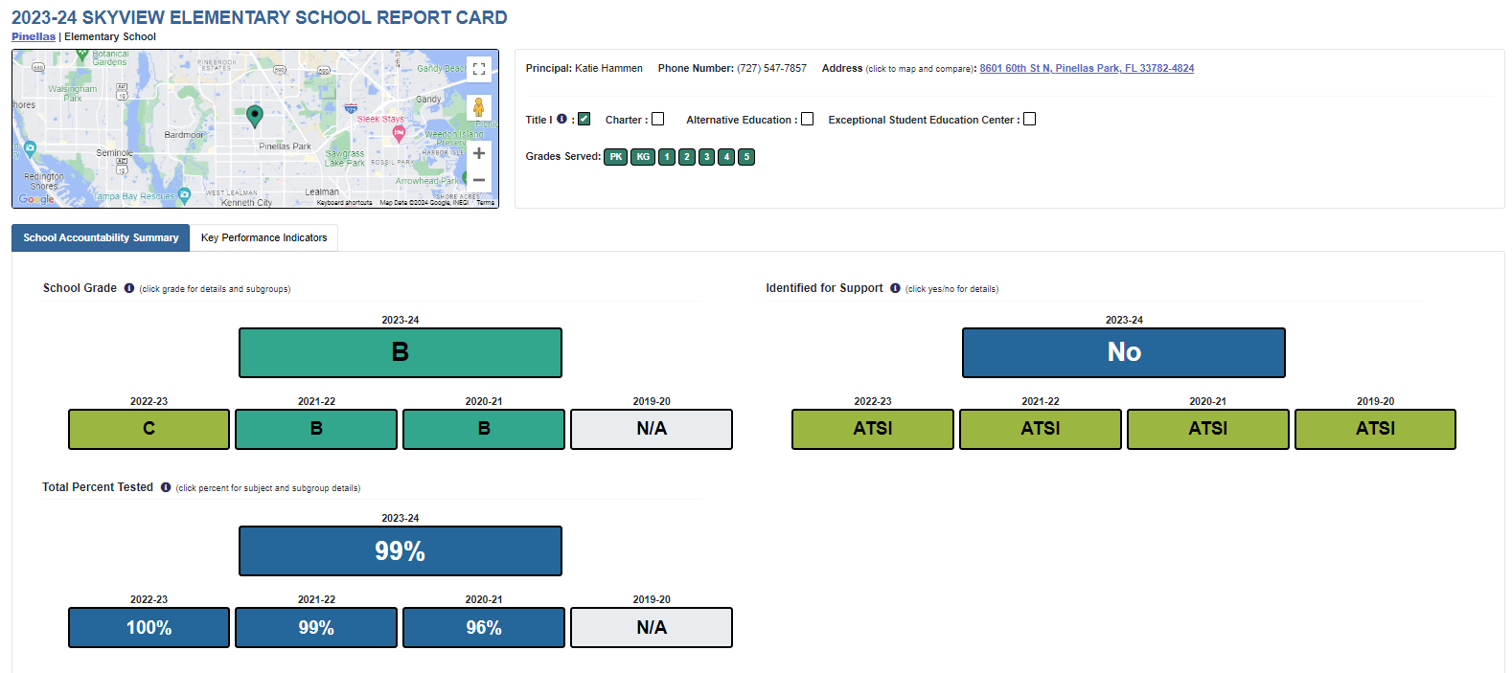
School Report Card

Slide 21
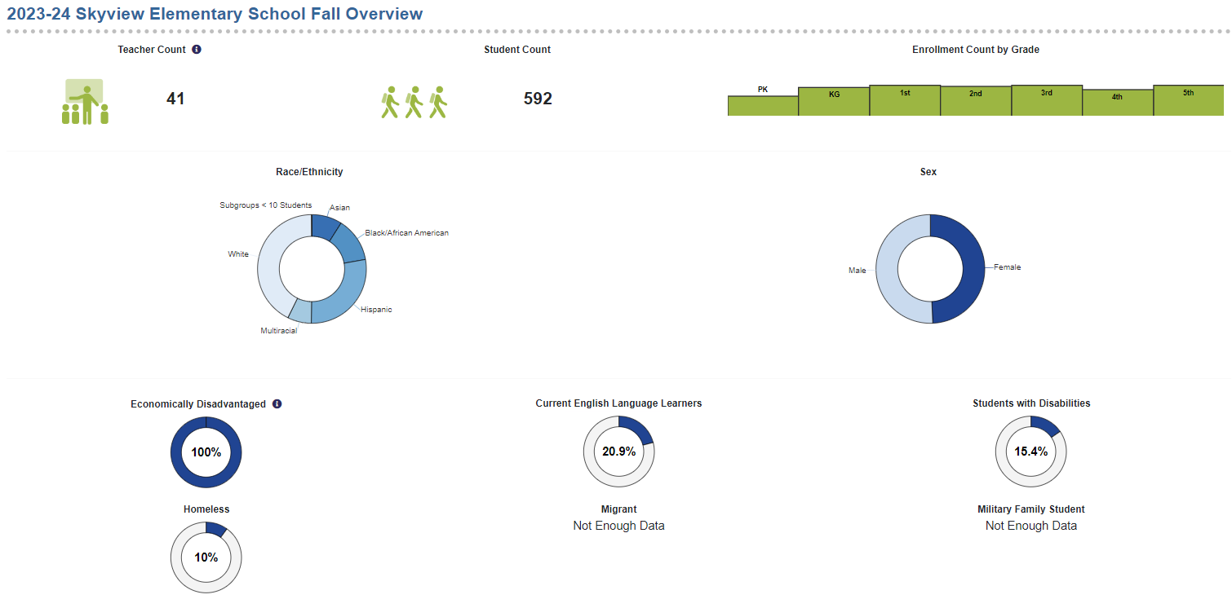
Population and Enrollment

Slide 22
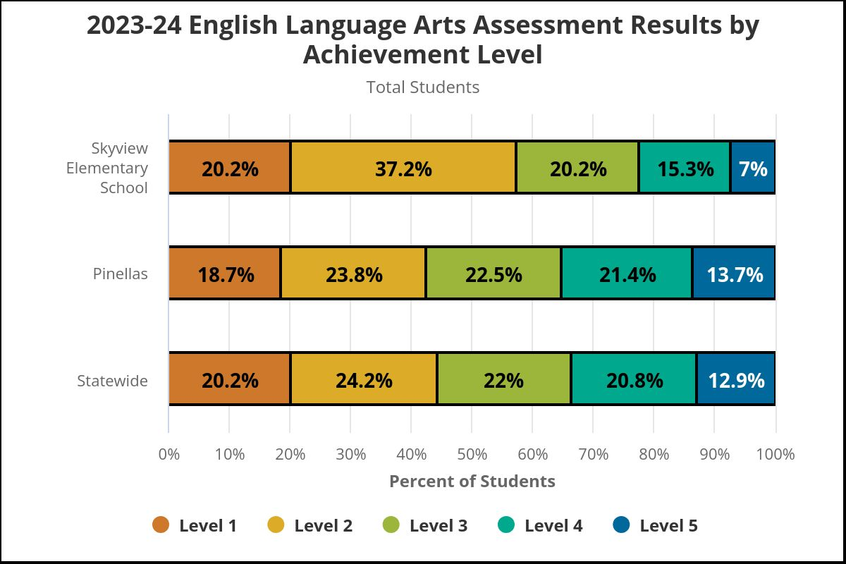
assessments - achievement

Slide 23
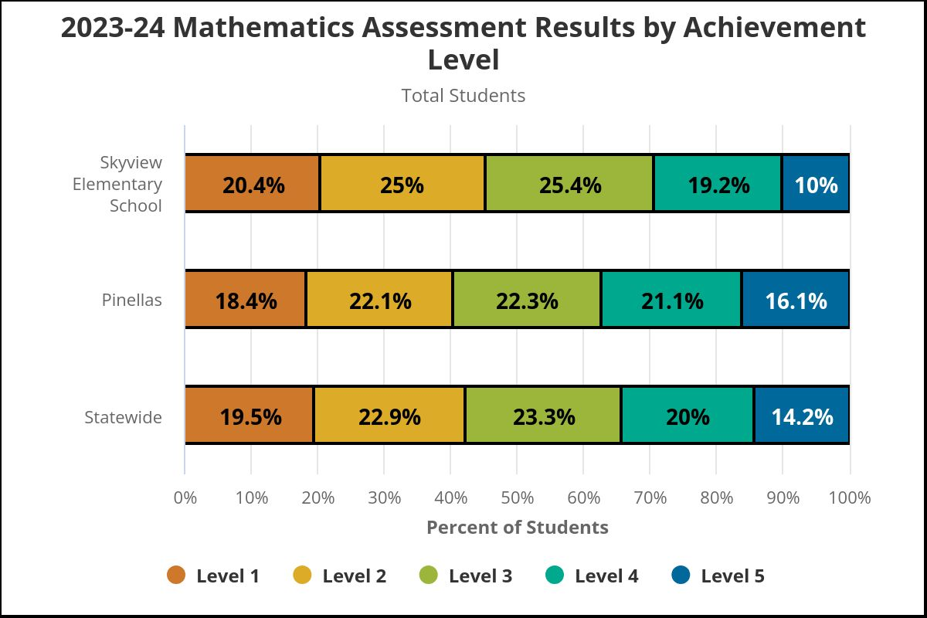
assessments - achievement

Slide 24
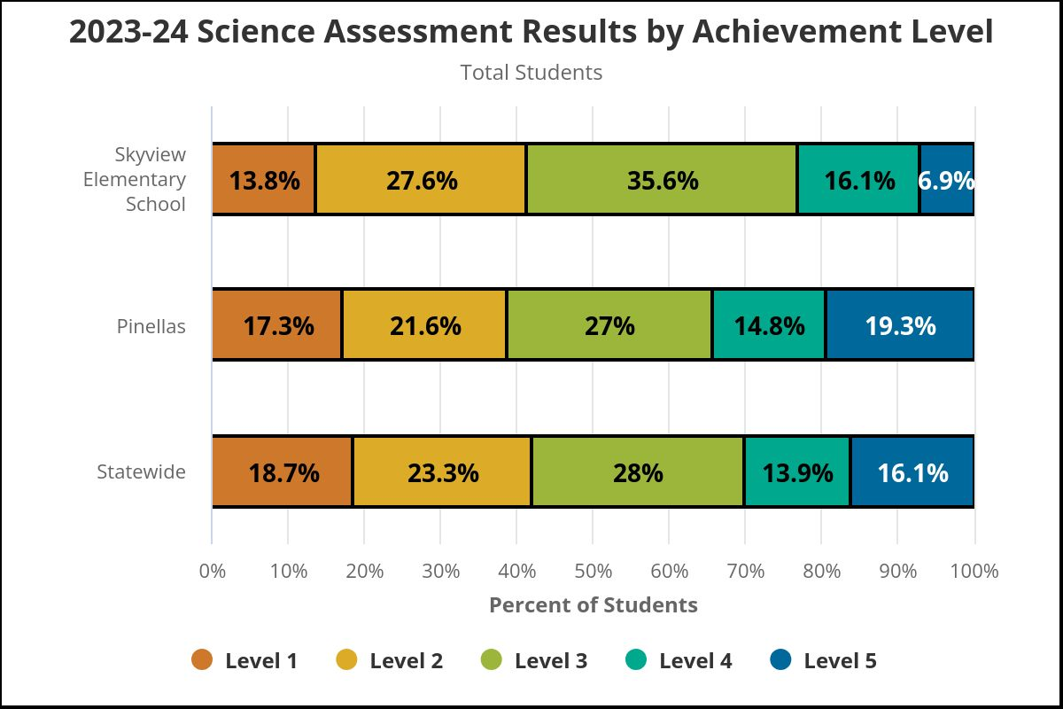
assessments - achievement

Slide 25
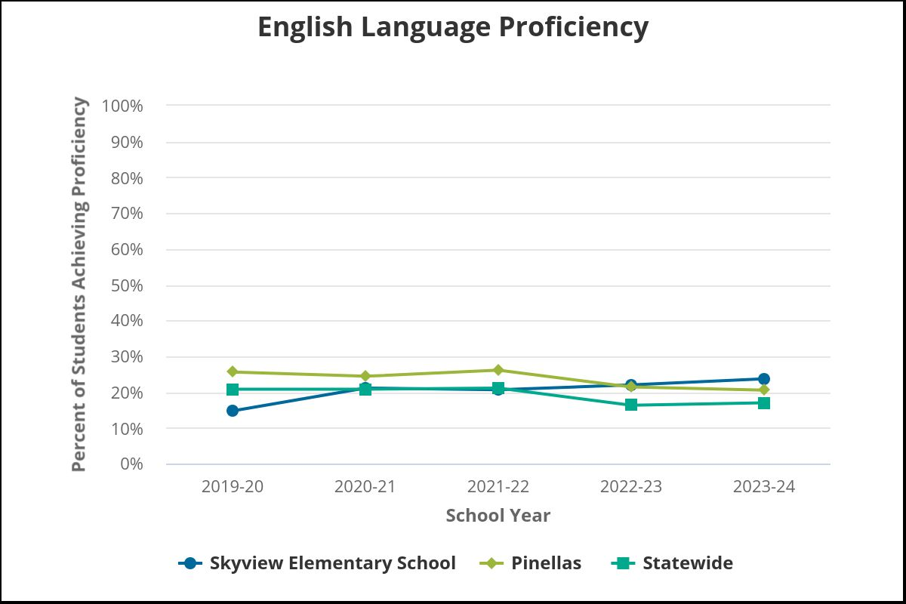
assessments – English language learners

Slide 26
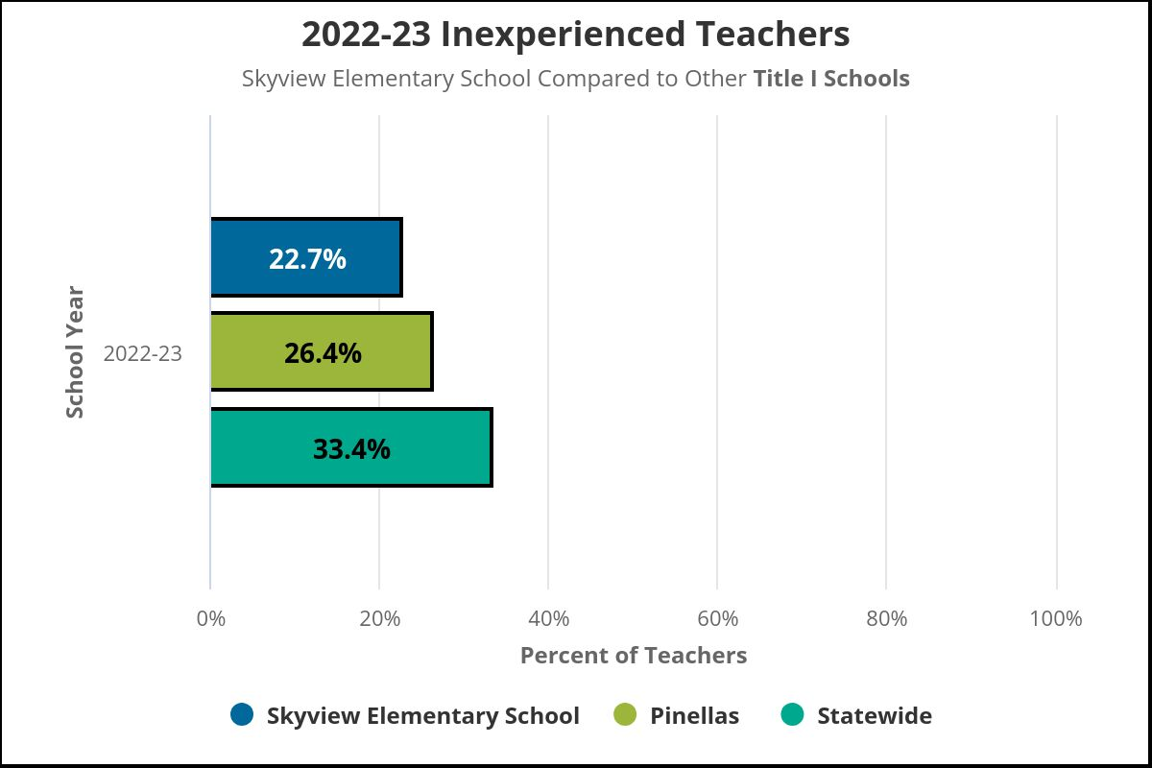
educator qualifications and equity

Slide 27
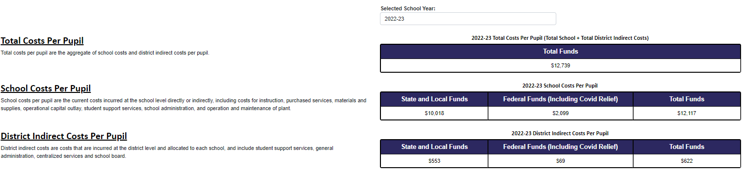
Per-pupil expenditures

Slide 28
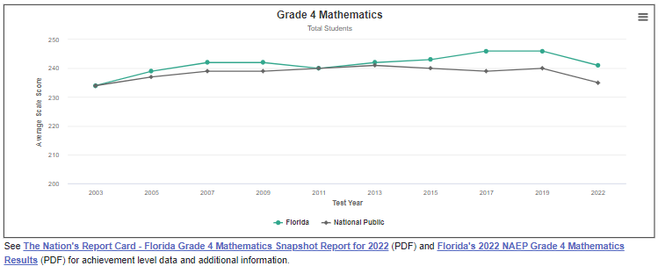
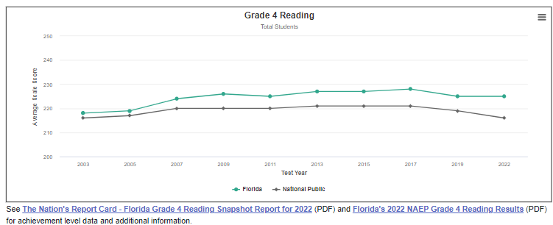
national data

Slide 29

October 14 – Title 1 Parent Teacher Conference Day
October 21-25 – Book Fair Week
October 24 – Spooktacular Story Fest
October 28-November 1 – Red Ribbon Week
November 13 – Great American Teach In
December 12 – Winter Concert – Kg, 2nd, 5th grades
Notes:
Do you have a calendar of key events that are included in your PFEP.
Evidence – Consider this as evidence to include to support Family Engagement.

Slide 30
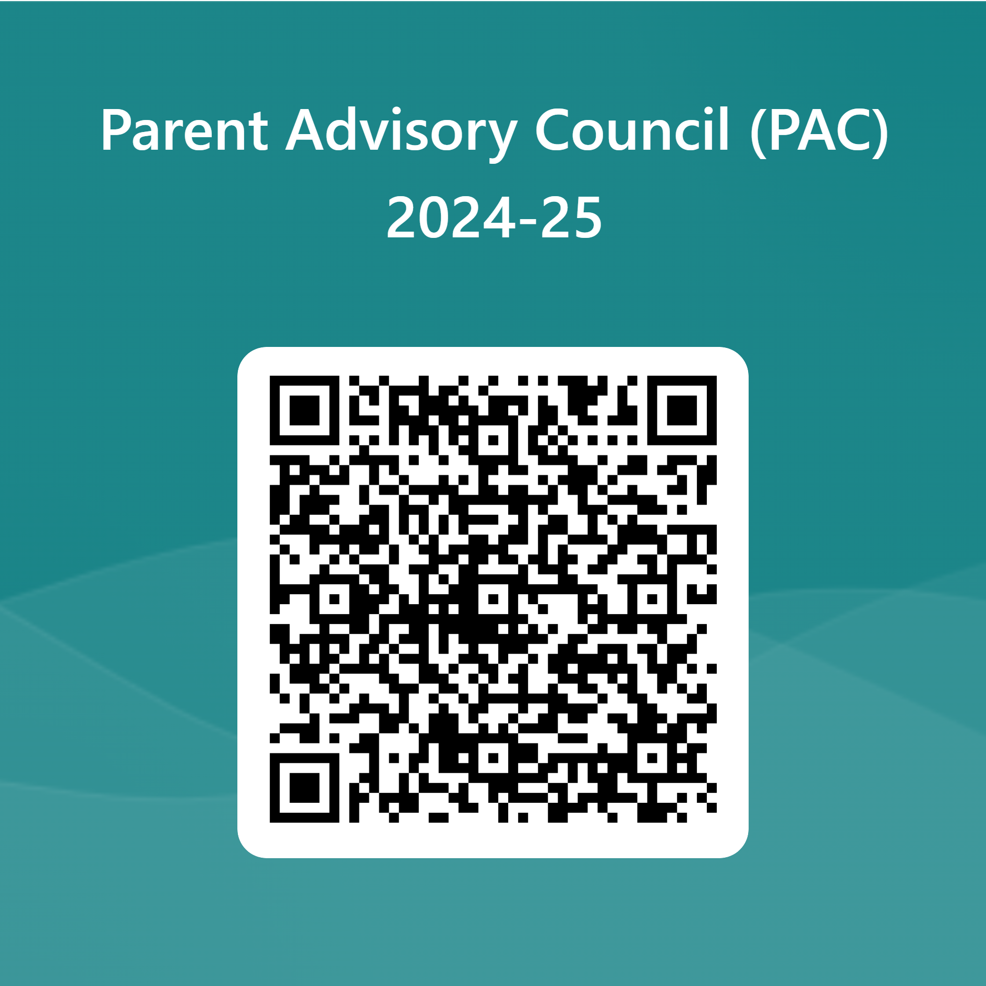

Parent Advisory Council (PAC)
The District has a Parent and Family Engagement Plan. The summary of the plan is in the Title I School & Family Partnership Overview.
You may access the full plan at www.pcsb.org/titleone
The Parent Advisory Council (PAC) is responsible for reviewing and revising the District PFEP.
PAC will meet virtually or in person with the district’s Title I staff.
Each school is committed to having at least one member representative in PAC.
PAC meets twice a year, if you are interested in representing our school please notify, Insert contact person
Notes:
Please add your PAC representative in slide and share with your Title I Specialist.
https://forms.office.com/r/r5daaMTENE\

Slide 31
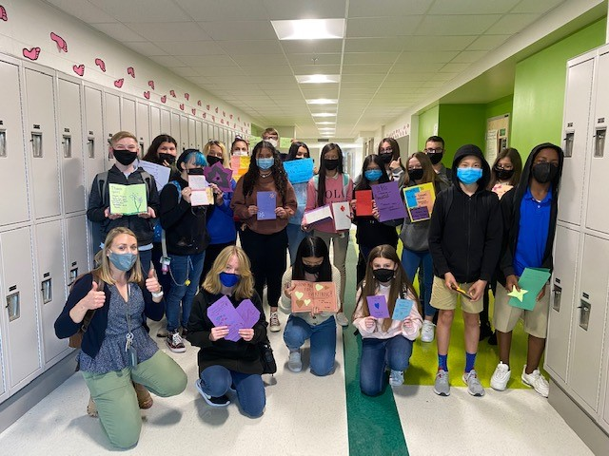

Additional Resources
Learning at Home Family Resources - https://www.pcsb.org/Page/32836
Volunteer in a Pinellas County School - https://www.pcsb.org/Page/459
Parent Academy POWER HOURS Webinars - https://www.pcsb.org/Page/26534
Partnerships - https://www.pcsb.org/Page/418

Slide 32
Contact Us
8601 60th Street N
Pinellas Park, FL 33782
727-547-7857
pcsb.org/skyview-es
Notes:
Please insert the school contact information and the best way to reach out to the school.

Slide 33


Slide 34
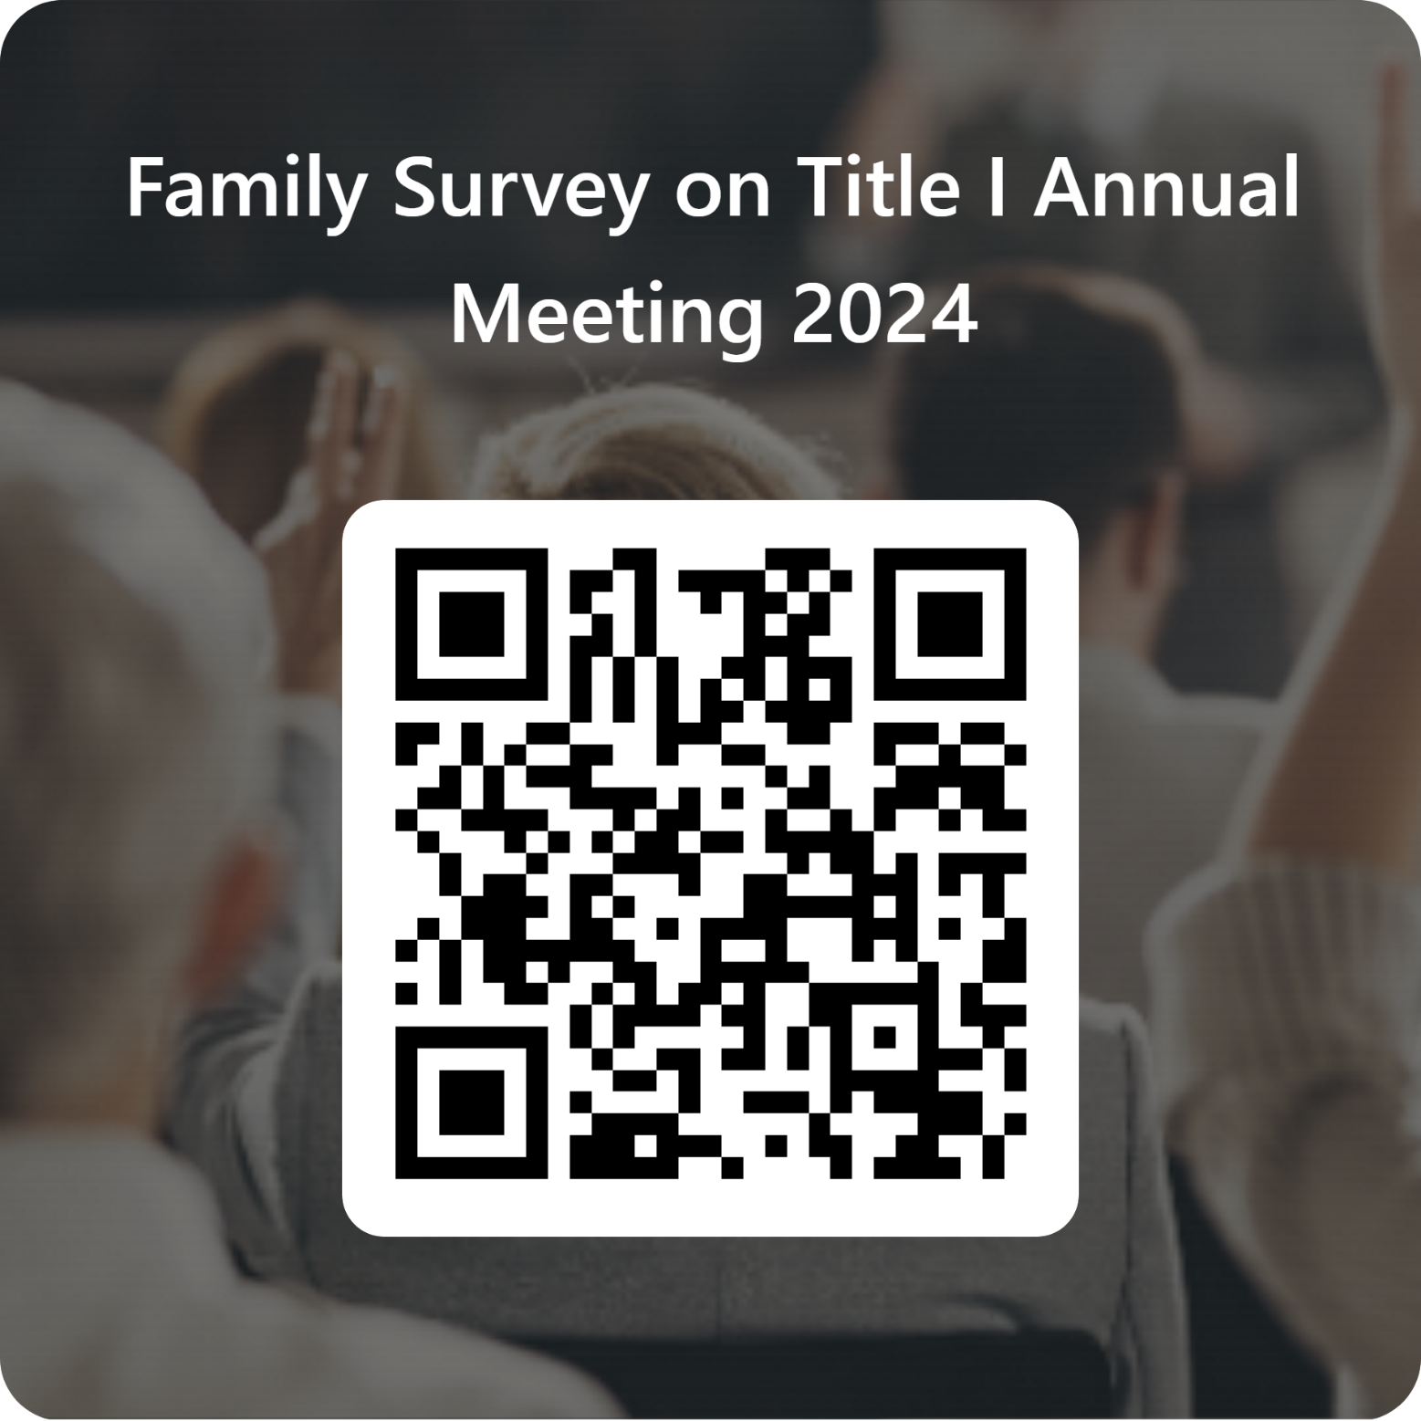
Please take the time to participate in our survey.
Your feedback is greatly appreciated!
Notes:
Please duplicate Microsoft Forms provided or create school survey. To generate a QR code hover over your school’s survey and and right click. Create QR code for this page will be an option.
https://forms.office.com/Pages/ShareFormPage.aspx?id=BZM8c9c5GkaGb_3ye_PH_x-1YNVO6C1FkgA88U6PR2tUNEQzTU0wNkZXVUxVTlpEMU81NkJFMlJNTi4u&sharetoken=FXXhmgwFjSnl0sNz61ki

Slide 35

Thank you for your time!

